Slide 1


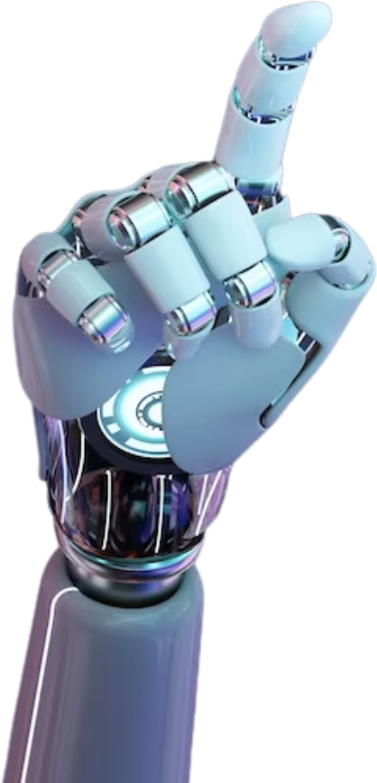


INTRO
AI TRAINING
CONCERN
RESOURCES
Get to know
Artificial Intelligence
From Scratch
Present by Qiqing
Definition
Next Slide
Artificial Intelligence (AI) is a field of computer science focused on building systems that can perform tasks which normally require human intelligence.
WHERE INNOVATION MEETS OPPORTUNITY.

Slide 2
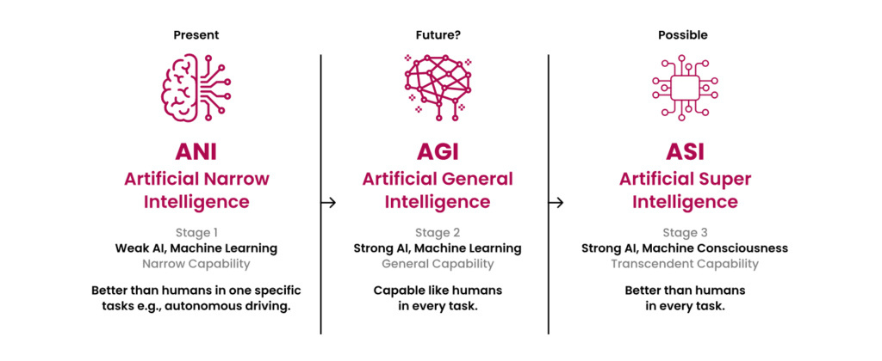
INTRO
AI TRAINING
CONCERN
RESOURCES
ARTIFICIAL INTELLIGENCE (AI) IS A FIELD OF COMPUTER SCIENCE FOCUSED ON BUILDING SYSTEMS THAT CAN PERFORM TASKS WHICH NORMALLY REQUIRE HUMAN INTELLIGENCE.

Slide 3


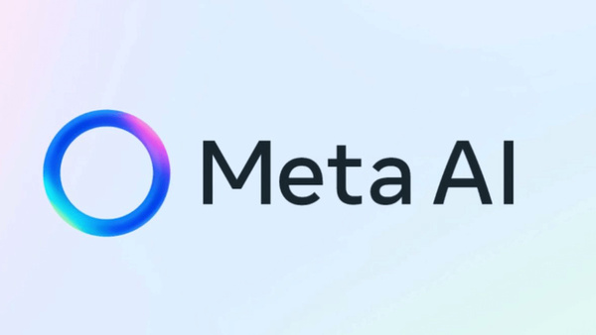

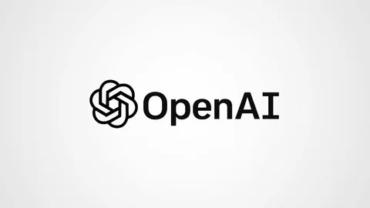

AI Giants

Slide 4
INTRO
AI TRAINING
CONCERN
RESOURCE
How do we create an
Artificial Intelligence
Define problem
Data collection
Data cleanning
Data labeling
DEFIN WHAT YOU WANT THE AI TO SOLVE, WHAT IS THE PROBLEM
GATHER RAW DATA TO FEED THE MODEL
NORMALLY LABLED
PROCESS THE GATHERED DATA AND REMOVE THE NOISES
ASSIGN THE CORRECT DATA TO AI IN ORDER FOR IT TO LEARN
Training
Safety training
Deployment
Feedback and lteration
THE MODEL START TO MAKE PREDICTIONS
SHAPE AI BEHAVIOR TO MATCH HUMAN NORMAL
TURN THE MODEL IN TO THE APPS
REVISE THE MODEL BASE ON THE FEEDBACKS RECEIVED

Slide 5
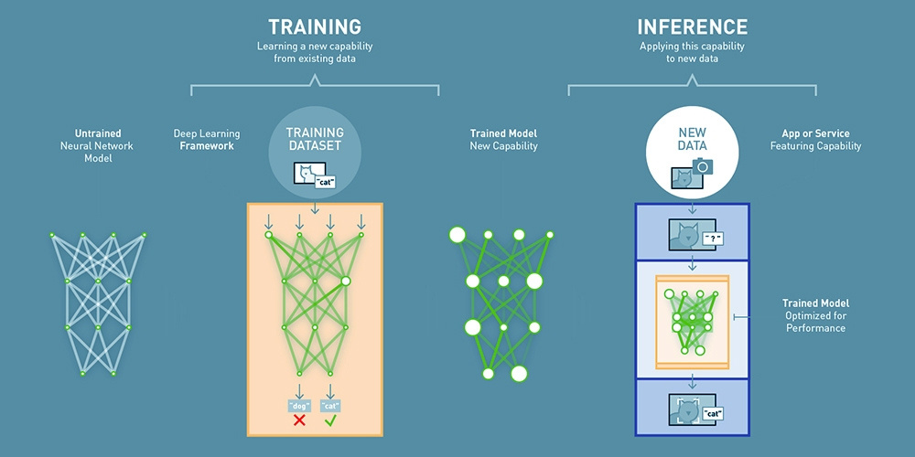
INTRO
AI TRAINING
CONCERN
RESOURCE
Deep learning worked!

Slide 6
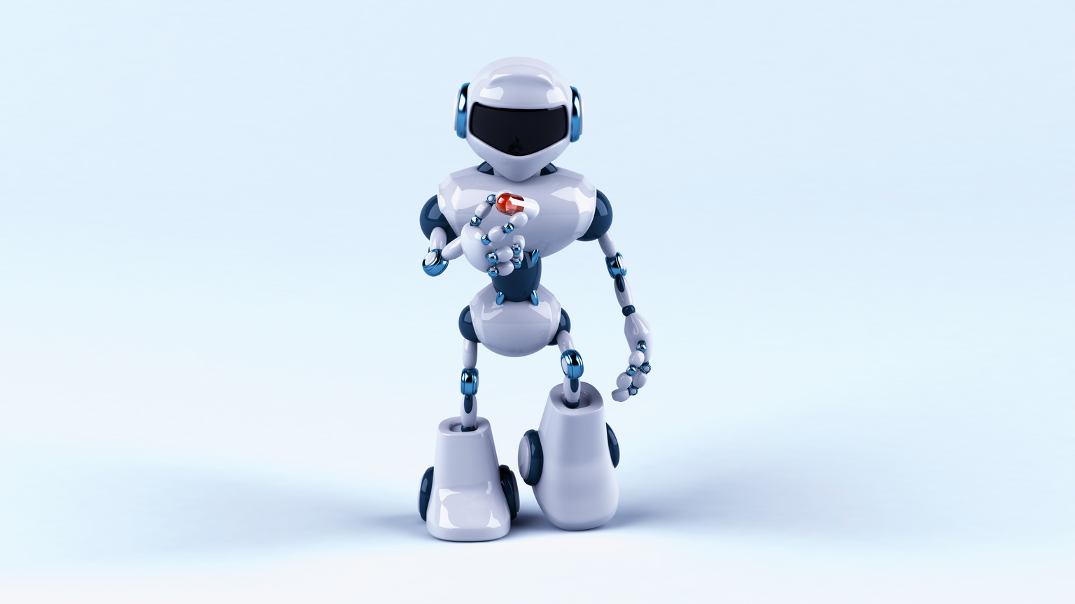
INTRO
AI TRANING
DEPLOY
RESOURCES
Ethical concerns of
Artificial Intelligence
Businesses are using AI to create more personalized, responsive, and engaging customer experiences. Chatbots, virtual assistants, and recommendation engines are helping brands stay connected to customers 24/7, enhancing loyalty and boosting sales.
Data privacy risks
Bias in algorithms
Escalate existing gaps
WHEN HANDLING SENSITIVE INFORMATION
AFFECTING FAIRNESS AND ACCURACY.
FOR DEVELOPMENT AND INTEGRATION.

Slide 7
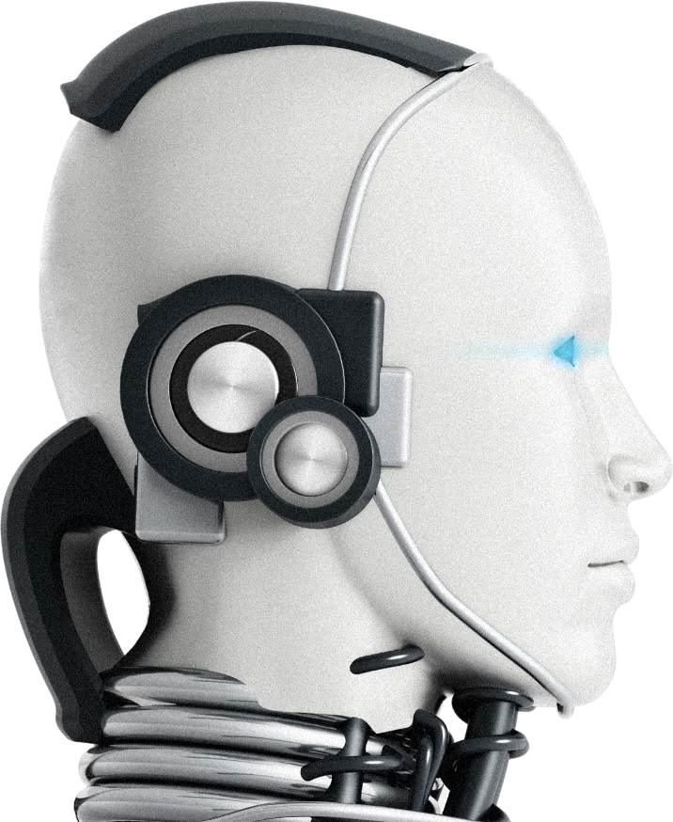
INTRO
AI TRANING
DEPLOY
RESOURCES
AI-powered tools are revolutionizing career growth by automating routine tasks, allowing professionals to focus on high-level strategy and creative problem-solving. By mastering these technologies, individuals can enhance their productivity, personalize their learning paths, and remain competitive in an evolving job market where data-driven insights define leadership and innovation.
How does
Artificial Intelligence
Empower your career
AI for career
DATA DRIVES DECISIONS—AND DESTINY.

Slide 8

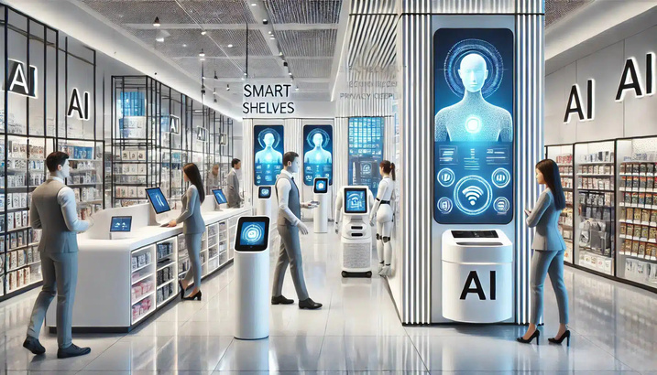
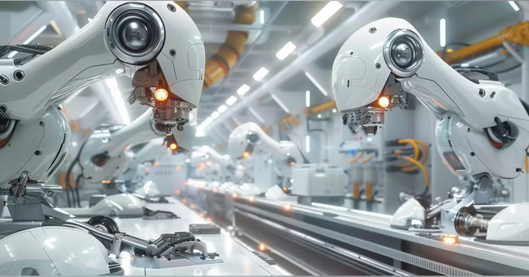
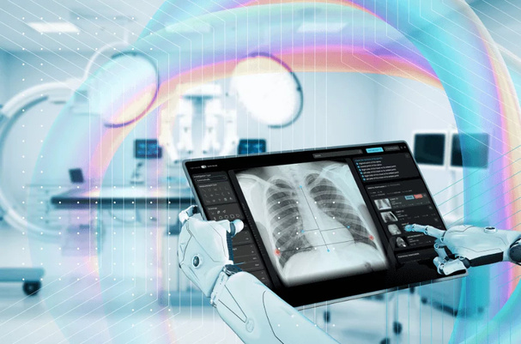
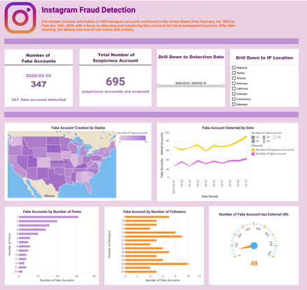
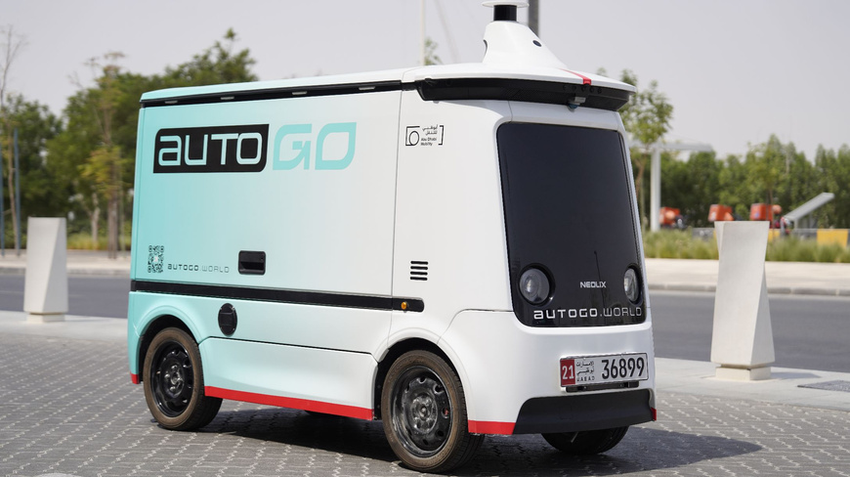
INTRO
AI TRANING
DEPOLY
RESOURCES
Industries are using
the AI

Slide 9
INTRO
AI TRANING
CONCERN
RESOURCES
Useful Resource
To Learn Ai
TOMORROW’S BREAKTHROUGHS START TODAY.
Code.org Elements of AI Machine Learning for Kids Day of AI (MIT)
Next Slide

Slide 10
INTRO
AI TRANING
CONCERN
RESOURCES
Embracing AI for
a better world
Artificial Intelligence is not a distant future—it’s the competitive edge of today. Companies that embrace AI thoughtfully and strategically are setting themselves up for sustainable growth, innovation, and leadership in the market.
www.globalshaper.org
-
maximum1998131@gmaill.com

